Slide 1
Trees

Slide 2
In this topic, we will cover:
Definition of a tree data structure and its components
Concepts of:
Root, internal, and leaf nodes
Parents, children, and siblings
Paths, path length, height, and depth
Ancestors and descendants
Ordered and unordered trees
Subtrees
Examples
XHTML and CSS

Slide 3
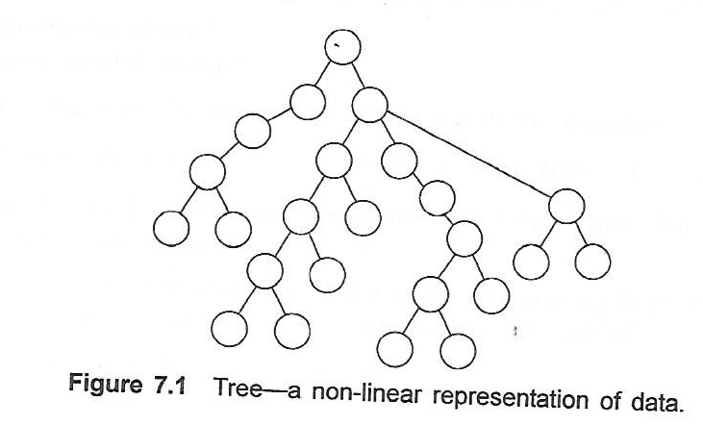
What is a Tree?
A tree is a data structure that stores data in a non-linear manner.

Slide 4
The tree data structure
We have already seen a number of data structures:
singly and doubly linked lists, one- and two-ended arrays, and circular arrays.
We will now look at a new data structure: the rooted tree
tree is a nonlinear data structure , it is used to represent hierarchical relationship between elements

Slide 5
terminologies
Root node
Child
Siblings
External/leaf node
Internal nodes
Subtree
Predecessor/ancestor
Sucessor/decendent
Edge
Path
Branch
Level

Slide 6
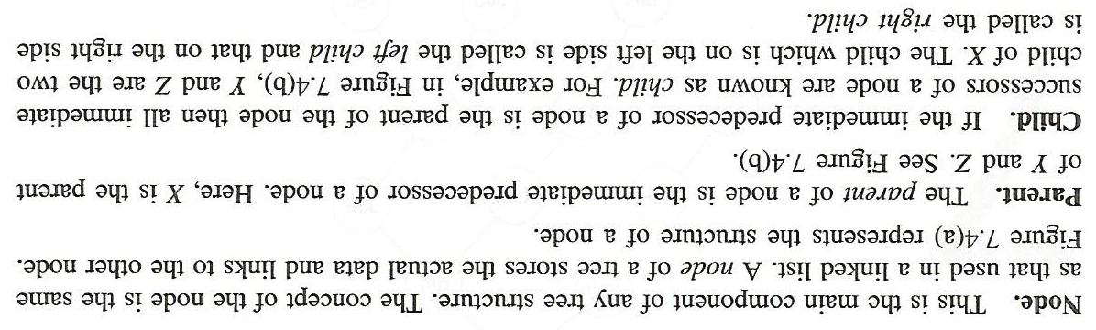
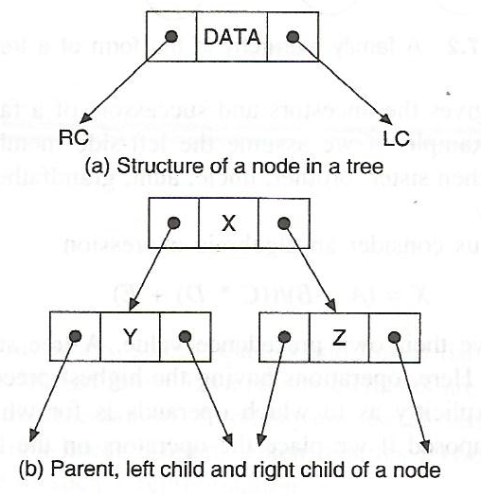
Basic Terminologies

Slide 7
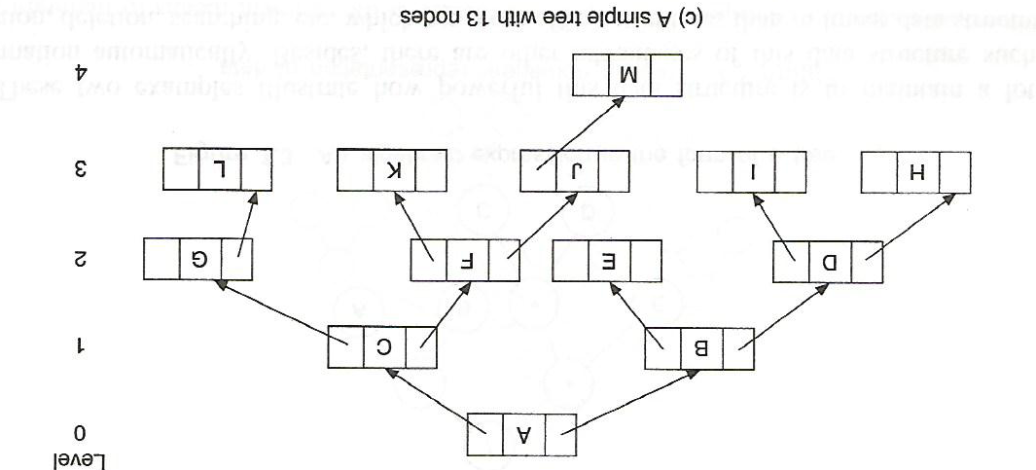
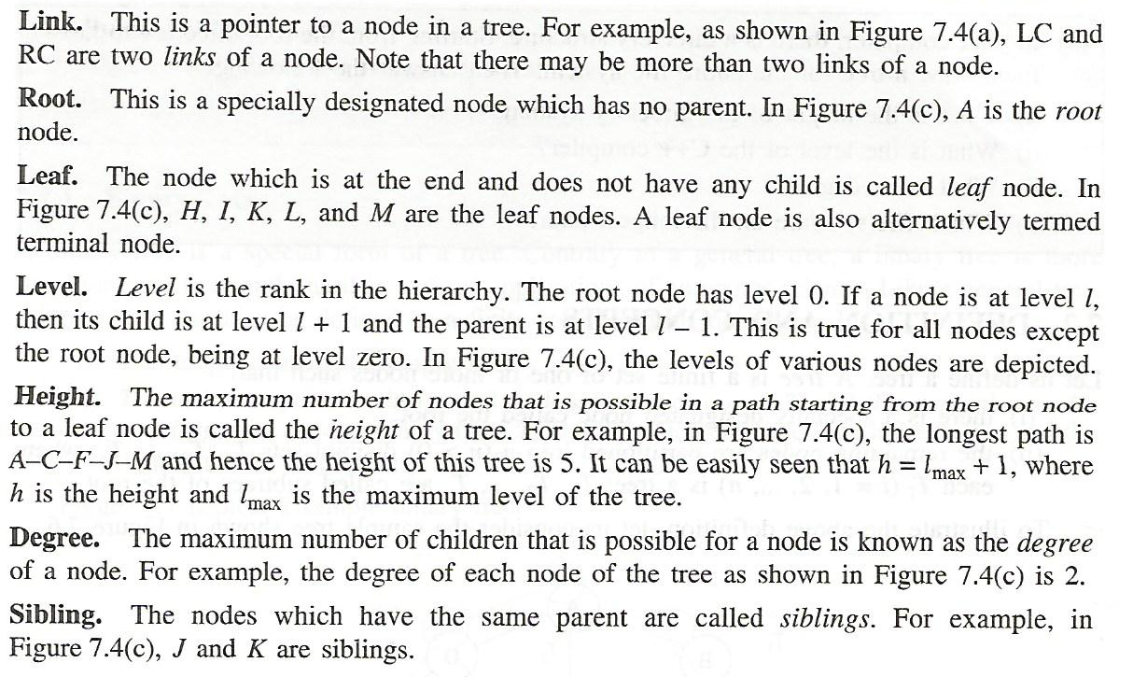

Slide 8
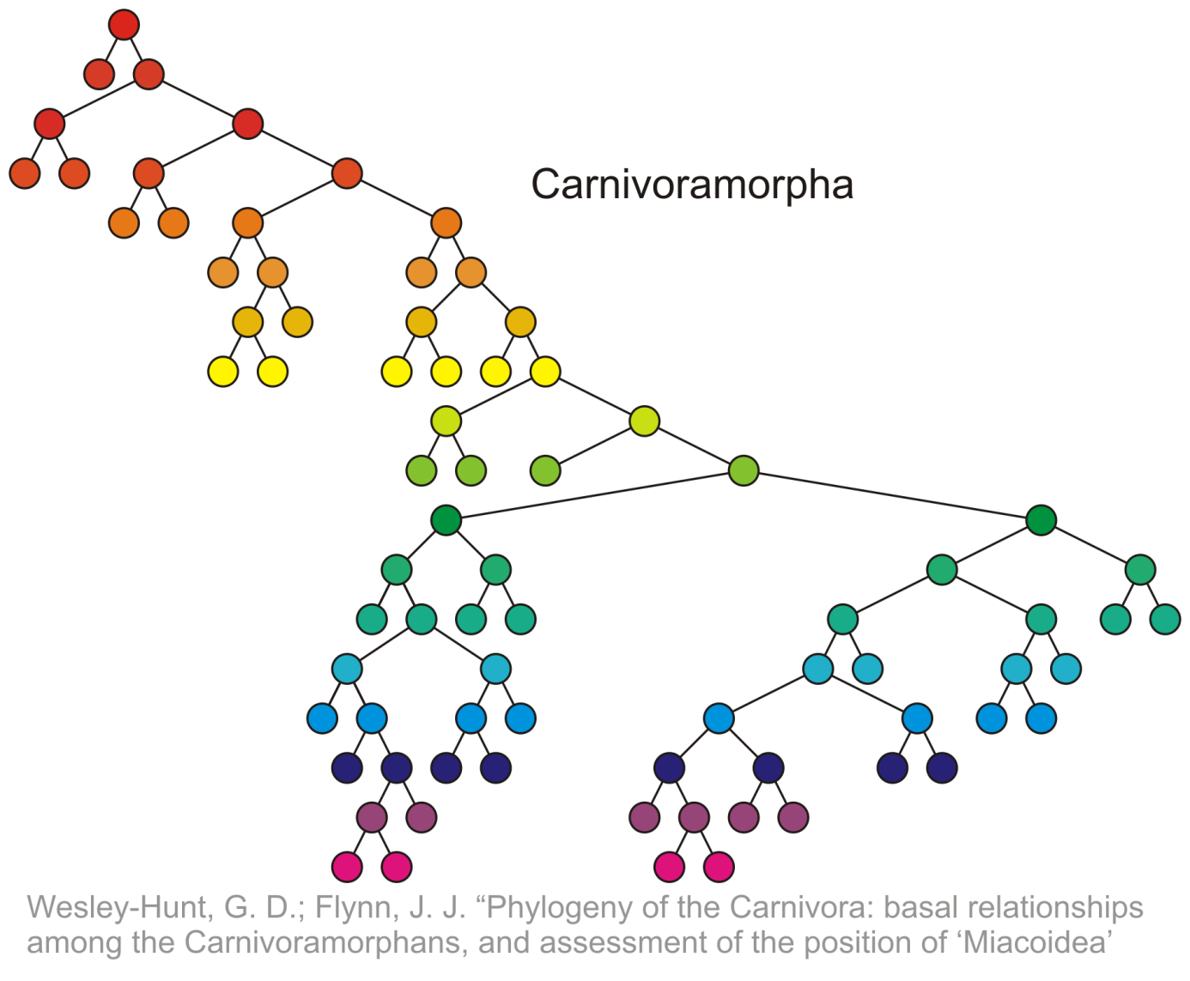
Terminology
The height of this tree is 17
17

Slide 9
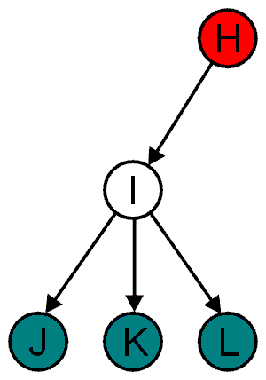
Terminology
All nodes will have zero or more child nodes or children
I has three children: J, K and L
For all nodes other than the root node, there is one parent node
H is the parent I

Slide 10
Terminology
4.1.1.1
The degree of a node is defined as the number of its children: deg(I) = 3
Nodes with the same parent are siblings
J, K, and L are siblings

Slide 11
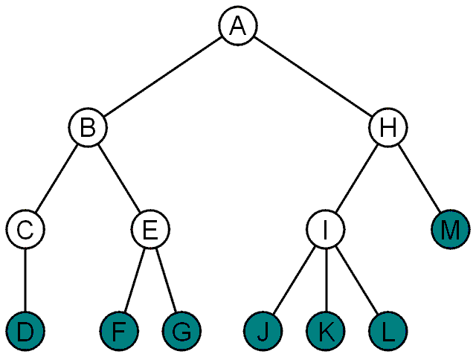
Terminology
4.1.1.1
Nodes with degree zero are also called leaf nodes
All other nodes are said to be internal nodes, that is, they are internal to the tree

Slide 12
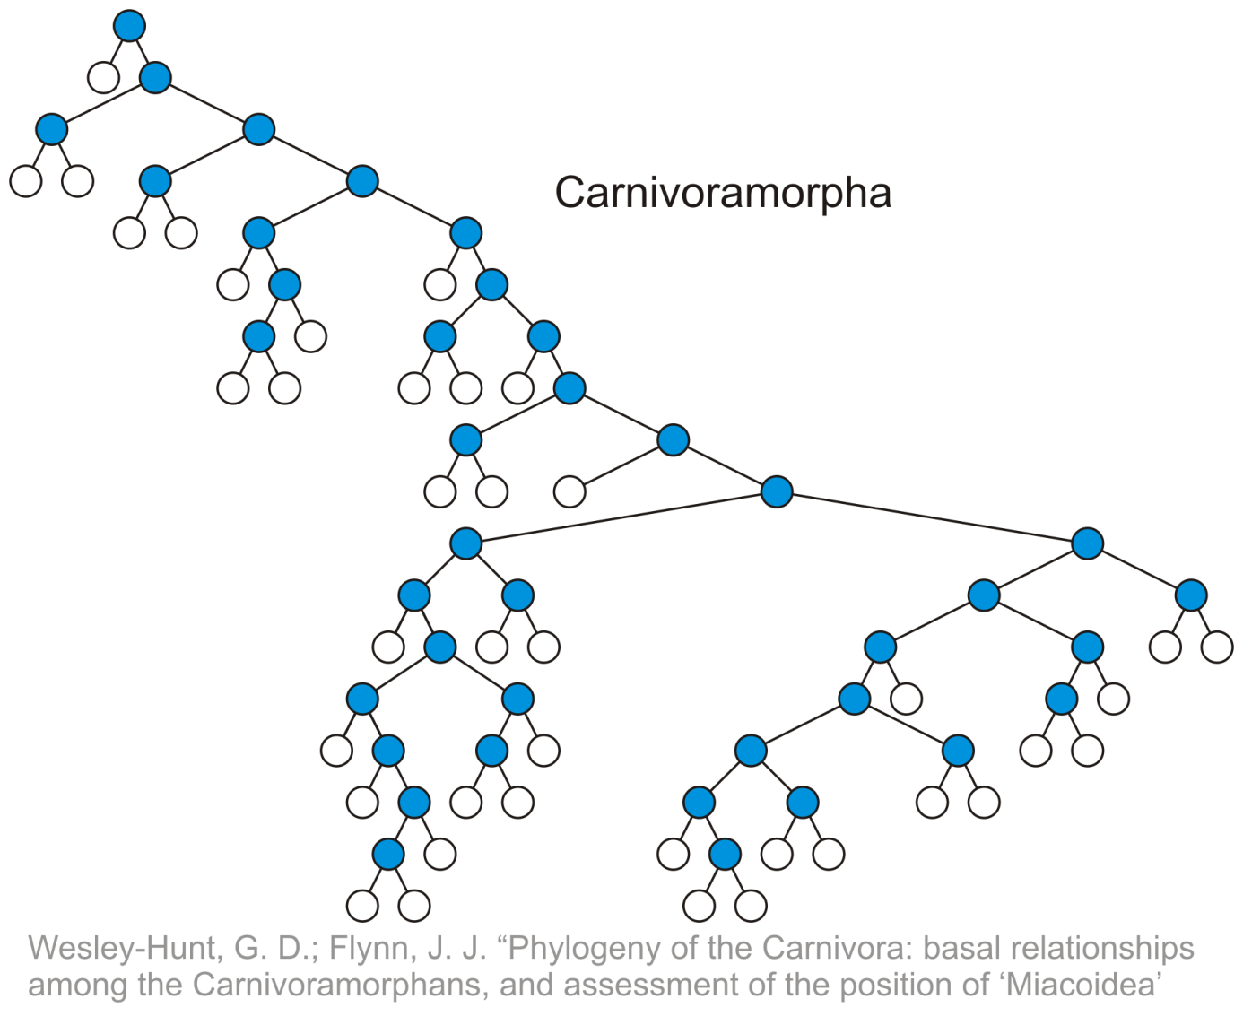
Internal nodes:
Having one or more child node

Slide 13
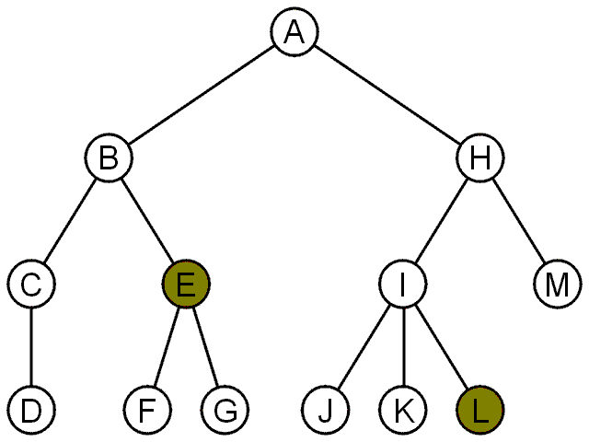
Terminology
For each node in a tree, there exists a unique path from the root node to that node
Depth is measure w.r.t root
The length of this path is the depth of the node, e.g.,
E has depth 2
L has depth 3

Slide 14
Terminology
4.1.1.3
0
Nodes of depth up to 17
4
9
14
17

Slide 15
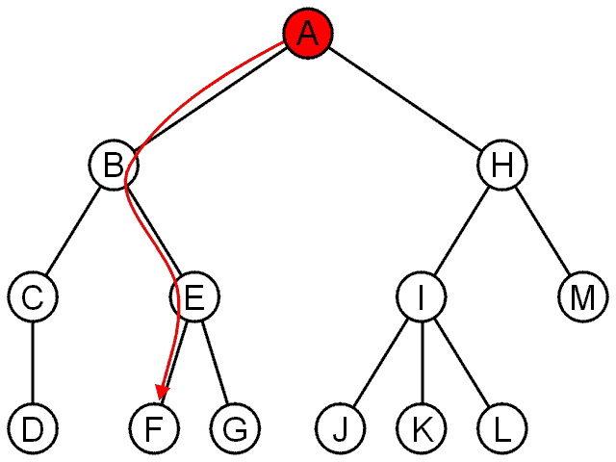
Terminology
The shape of a rooted tree gives a natural flow from the root node, or just root
The natural flow from the root to any node within the tree.

Slide 16
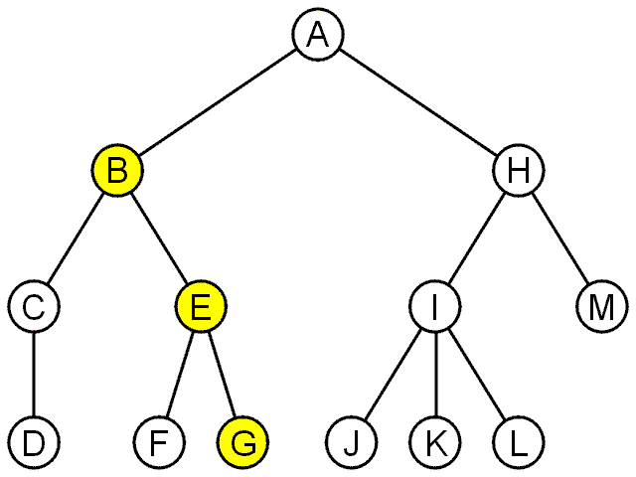
Terminology
A path is a sequence of nodes
(a₀, a₁, ..., a_{n})
where a_{k + 1} is a child of a_{k} is
The length of this path is n
E.g., the path (B, E, G) has length 2

Slide 17
Terminology
The height of a tree is defined as the maximum depth of any node within the tree
The height of a tree with one node is 0
Just the root node
Maximum path length between the node and a leaf node or max number of descendent along a path (excluding it self) leaf node
Height measure from the bottom

Slide 18
Terminology
If a path exists from node a to node b:
a is an ancestor of b
b is a descendent of a
Thus, a node is both an ancestor and a descendant of itself
We can add the adjective strict to exclude equality: a is a strict descendent of b if a is a descendant of b but a ≠ b
The root node is an ancestor of all nodes

Slide 19
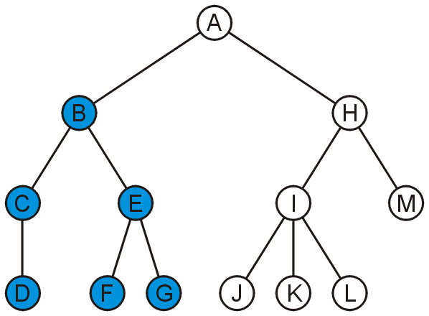
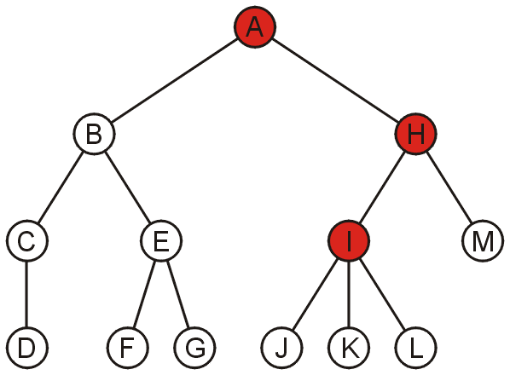
Terminology
4.1.1.4
The descendants of node B are B, C, D, E, F, and G:
The ancestors of node I are I, H, and A:

Slide 20
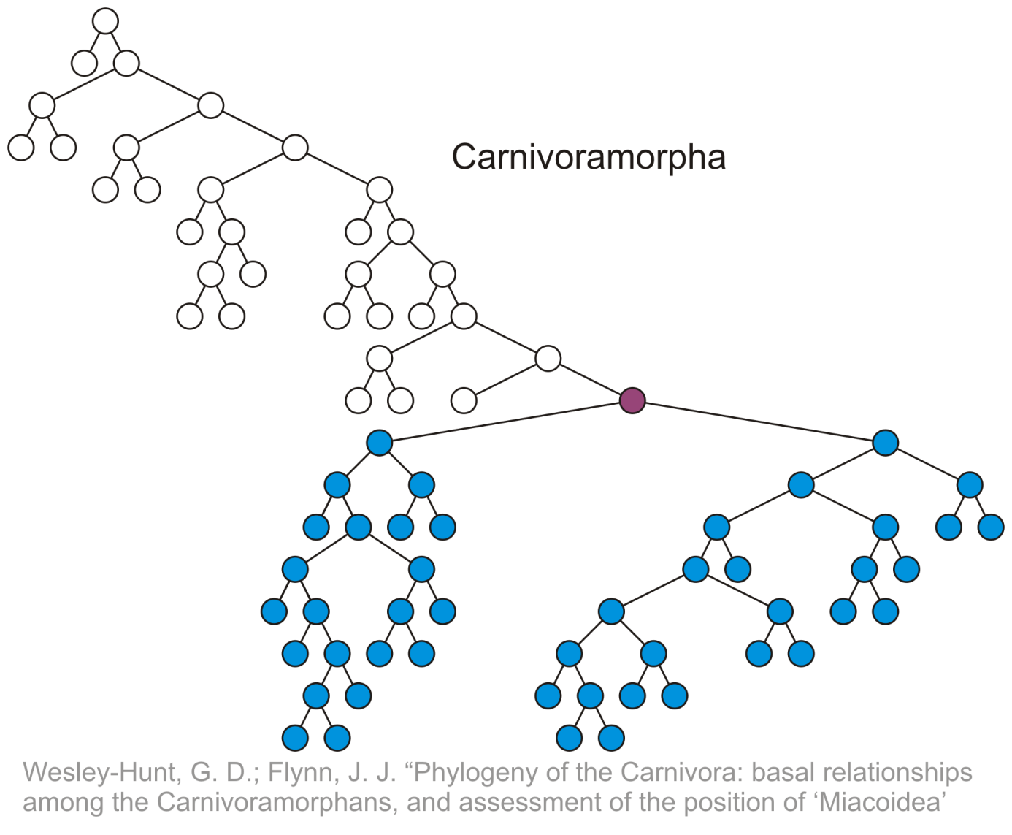
Terminology
4.1.1.4
All descendants (including itself) of the indicated node

Slide 21
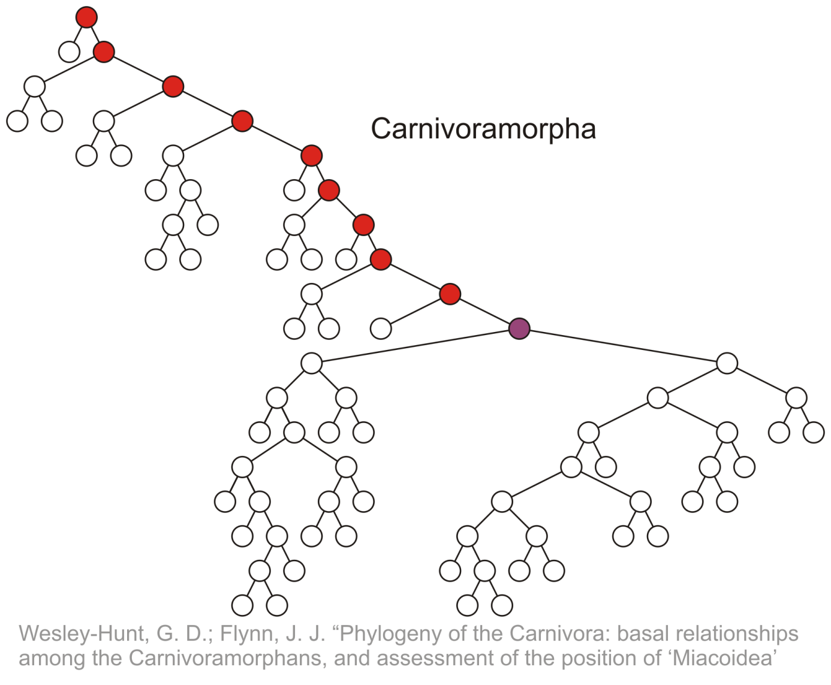
Terminology
All ancestors (including itself) of the indicated node

Slide 22
Binary tree
It is an ordered tree in which every node has at most 2 children
Each children is labelled either left or right child

Slide 23
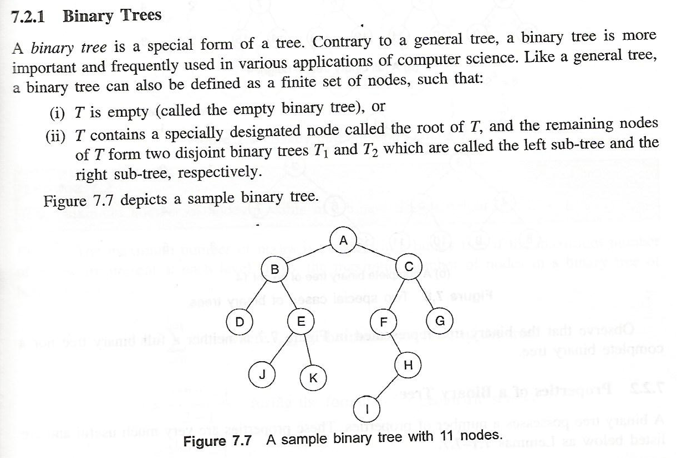

Slide 24

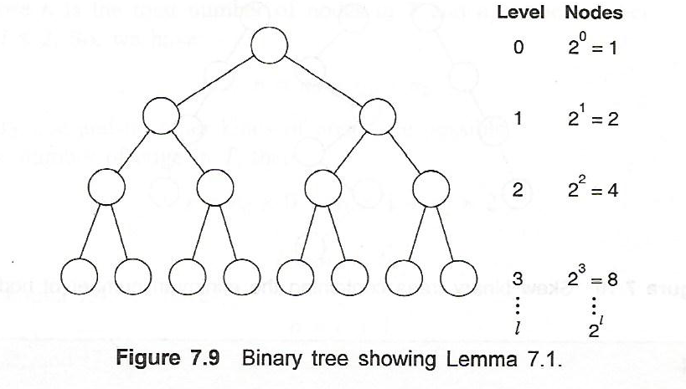
Properties of a Binary Tree

Slide 25
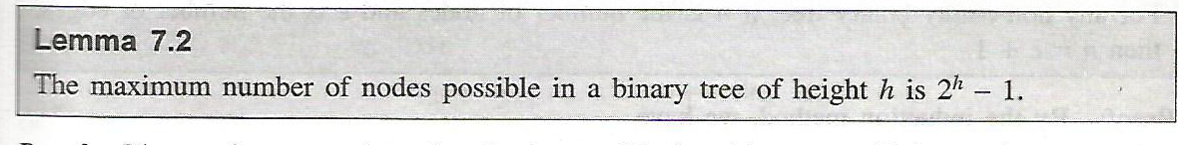
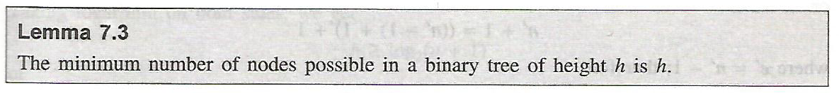
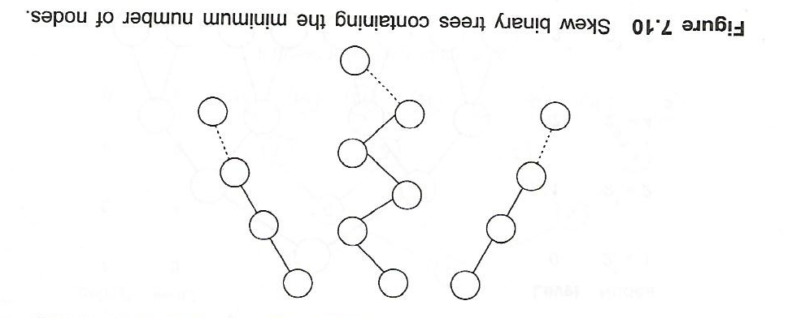

Slide 26
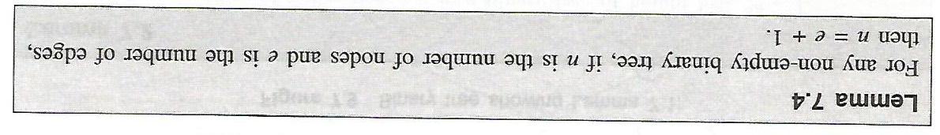
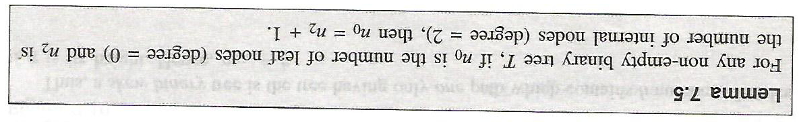
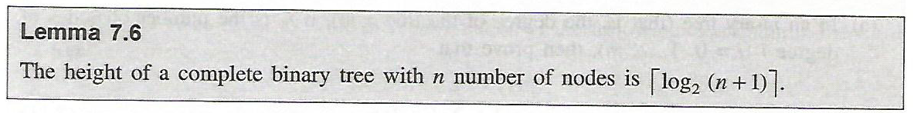

Slide 27
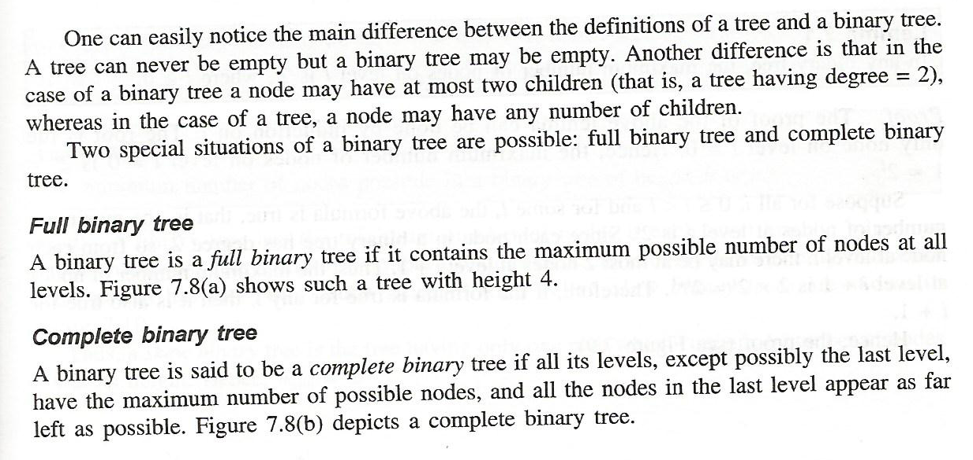

Slide 28
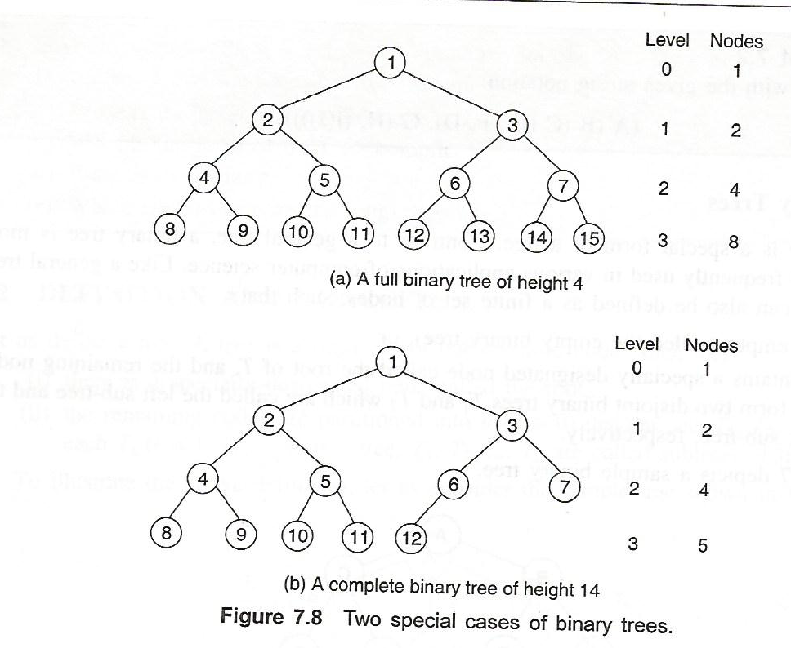

Slide 29
Example: XHTML and CSS
The XML of XHTML has a tree structure
Cascading Style Sheets (CSS) use the tree structure to modify the display of HTML

Slide 30
Example: XHTML and CSS
Consider the following XHTML document
<html>
<head>
<title>Hello World!</title>
</head>
<body>
<h1>This is a <u>Heading</u></h1>
<p>This is a paragraph with some
<u>underlined</u> text.</p>
</body>
</html>

Slide 31
Example: XHTML and CSS
Consider the following XHTML document
<html>
<head>
<title>Hello World!</title>
</head>
<body>
<h1>This is a <u>Heading</u></h1>
<p>This is a paragraph with some
<u>underlined</u> text.</p>
</body>
</html>
title
heading
body of page
underlining
paragraph

Slide 32
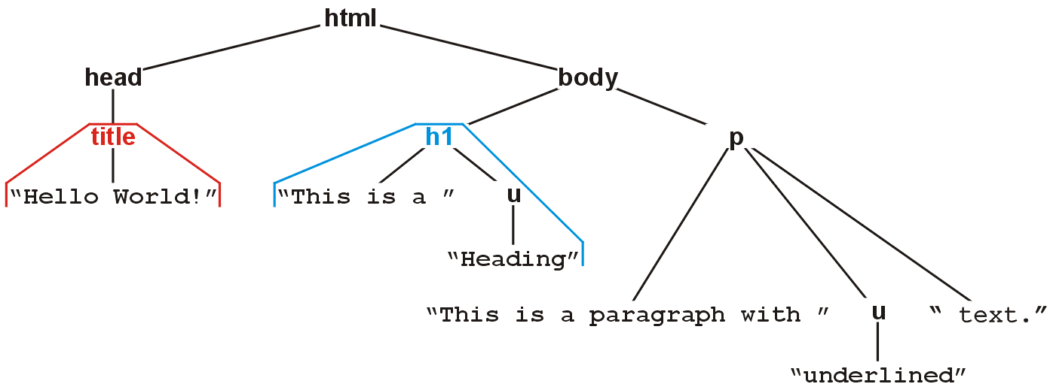
Example: XHTML and CSS
The nested tags define a tree rooted at the HTML tag
<html>
<head>
<title>Hello World!</title>
</head>
<body>
<h1>This is a <u>Heading</u></h1>
<p>This is a paragraph with some
<u>underlined</u> text.</p>
</body>
</html>

Slide 33

Example: XHTML and CSS
Web browsers render this tree as a web page

Slide 34
Example: XHTML and CSS
XML tags <tag>...</tag> must be nested
For example, to get the following effect:
1 2 3 4 5 6 7 8 9
you may use
<u>1 2 3 <b>4 5 6</b></u><b> 7 8 9</b>
You may not use:
<u>1 2 3 <b>4 5 6</u> 7 8 9</b>

Slide 35
Example: XHTML and CSS
4.1.3.1
Cascading Style Sheets (CSS) make use of this tree structure to describe how HTML should be displayed
For example:
<style type="text/css">
h1 { color:blue; }
</style>
indicates all text/decorations descendant from an h1 header should be blue

Slide 36
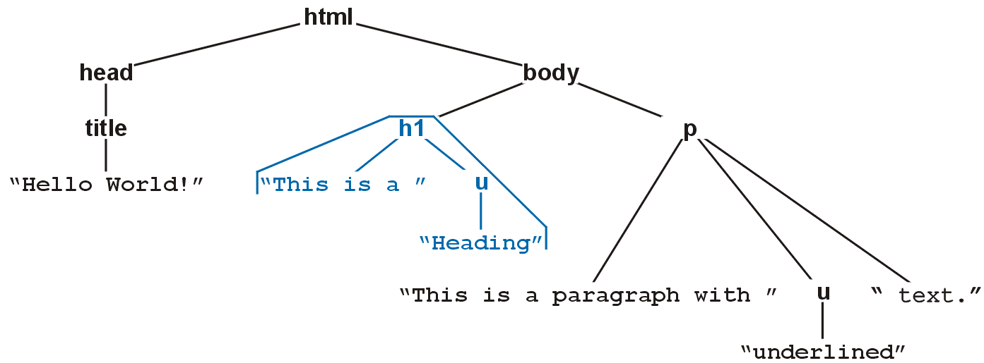

Example: XHTML and CSS
4.1.3.1
For example, this style renders as follows:
<style type="text/css">
h1 { color:blue; }
</style>

Slide 37
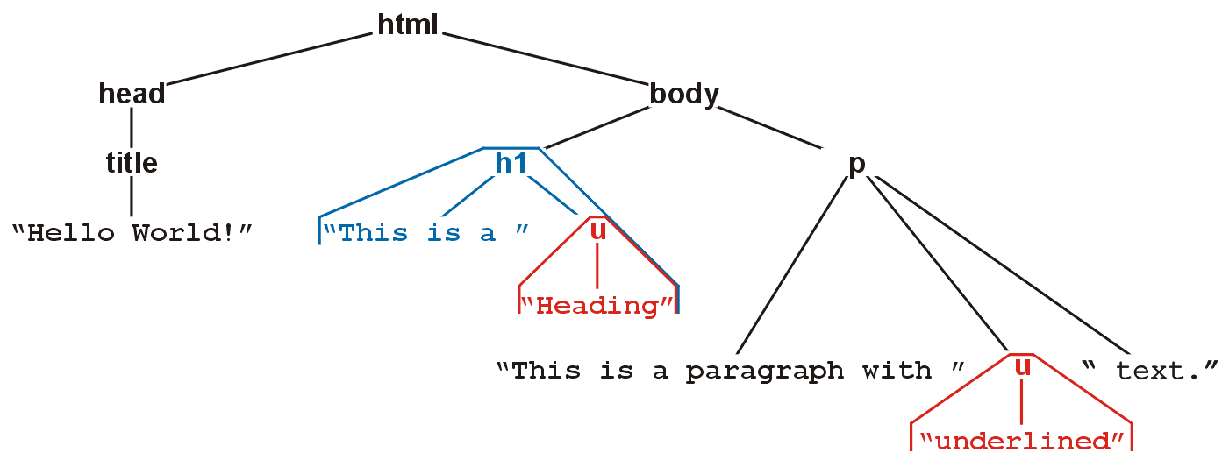

Example: XHTML and CSS
4.1.3.1
For example, this style renders as follows:
<style type="text/css">
h1 { color:blue; }
u { color:red; }
</style>

Slide 38
Example: XHTML and CSS
4.1.3.1
Suppose you don’t want underlined items in headers (h1) to be red
More specifically, suppose you want any underlined text within paragraphs to be red
That is, you only want text marked as <u>text</u> to be underlined if it is a descendant of a <p> tag

Slide 39
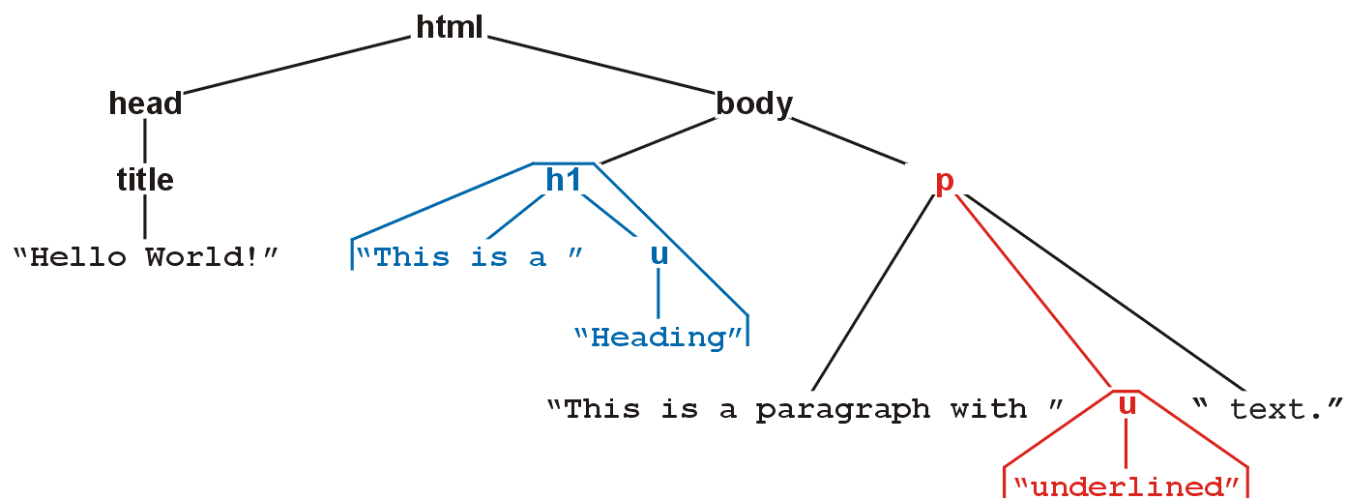

Example: XHTML and CSS
4.1.3.1
For example, this style renders as follows:
<style type="text/css">
h1 { color:blue; }
p u { color:red; }
</style>

Slide 40
References
[1] Donald E. Knuth, The Art of Computer Programming, Volume 1: Fundamental Algorithms, 3rd Ed., Addison Wesley, 1997, §2.2.1, p.238.
Douglas Wilhelm Harder, MMath

